Slide 1
DXC REAL-TIME PROJECTS
PRESENTED BY:
JYOTHI CHANDANA VOLETI
DXC262AB1218

Slide 2
CONTENTS
PROJECT 1 : CONNECTED VEHICLES
PROJECT 2 : AP MORGAN DATA PLATFORM

Slide 3
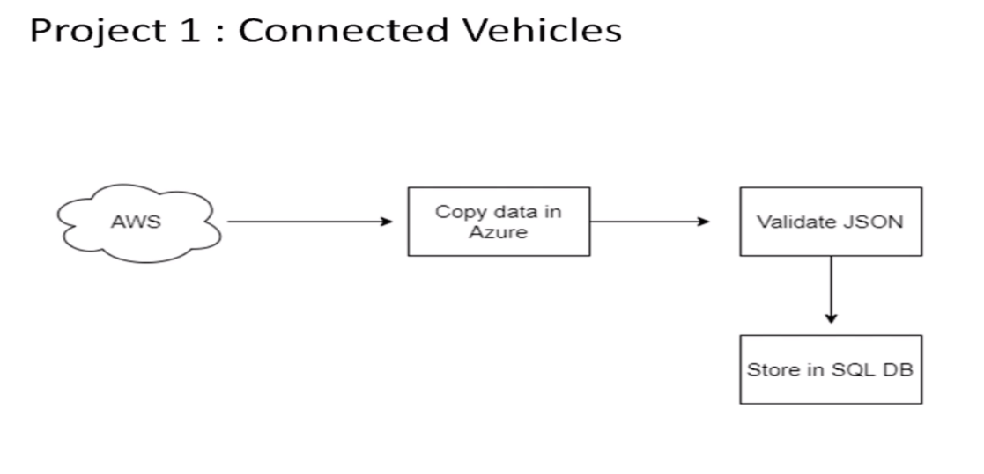
PROJECT 1 : CONNECTED VEHICLES
AIM: Moving data from Staging to SQL DB using pipelines.
PROJECT OUTLINE:

Slide 4
OUR TASK
Creating azure data factory
Creating Azure data factory pipeline
Creating blob trigger logic
Creating azure sql server and database
Adding another pipeline to move data from staging to sql database

Slide 5
RESOURCES
To complete this project we need the resources
Azure Data Factory
Azure Storage Account
Azure SQL Database

Slide 6
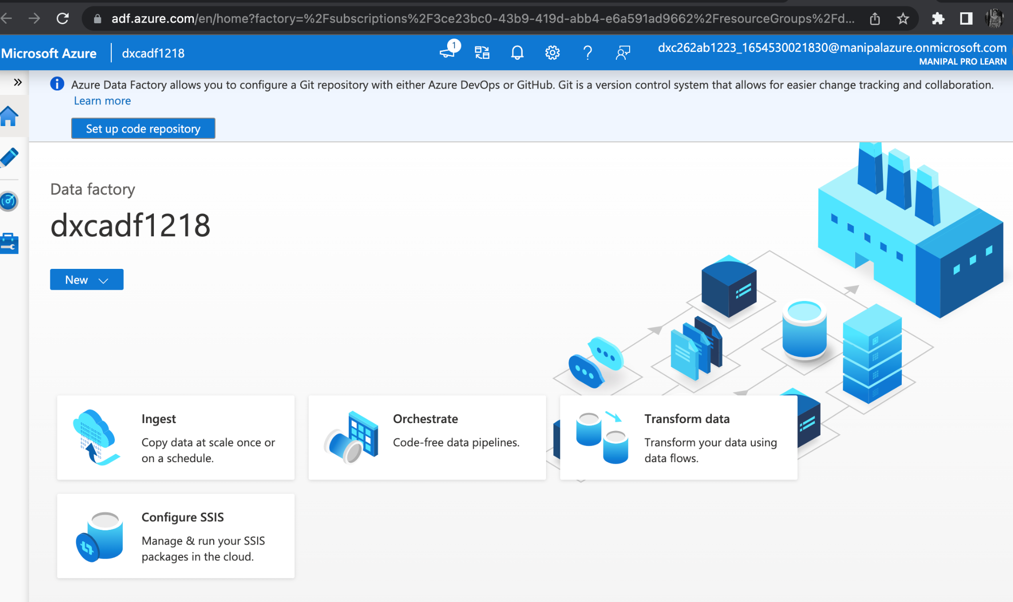
AZURE DATA FACTORY
Create Azure Data Factory

Slide 7
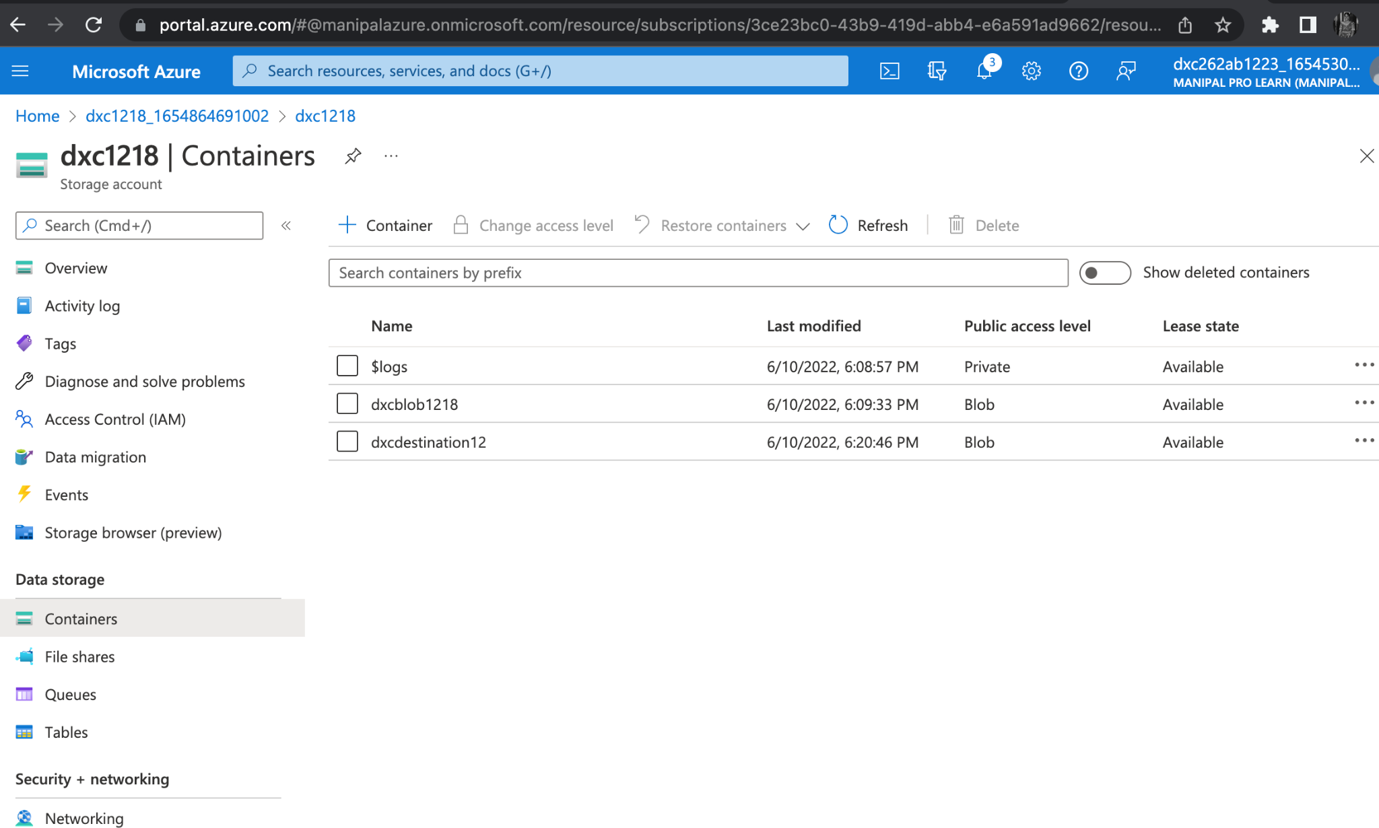
AZURE STORAGE ACCOUNT
Create an Azure Storage Account with source container and destination container.

Slide 8
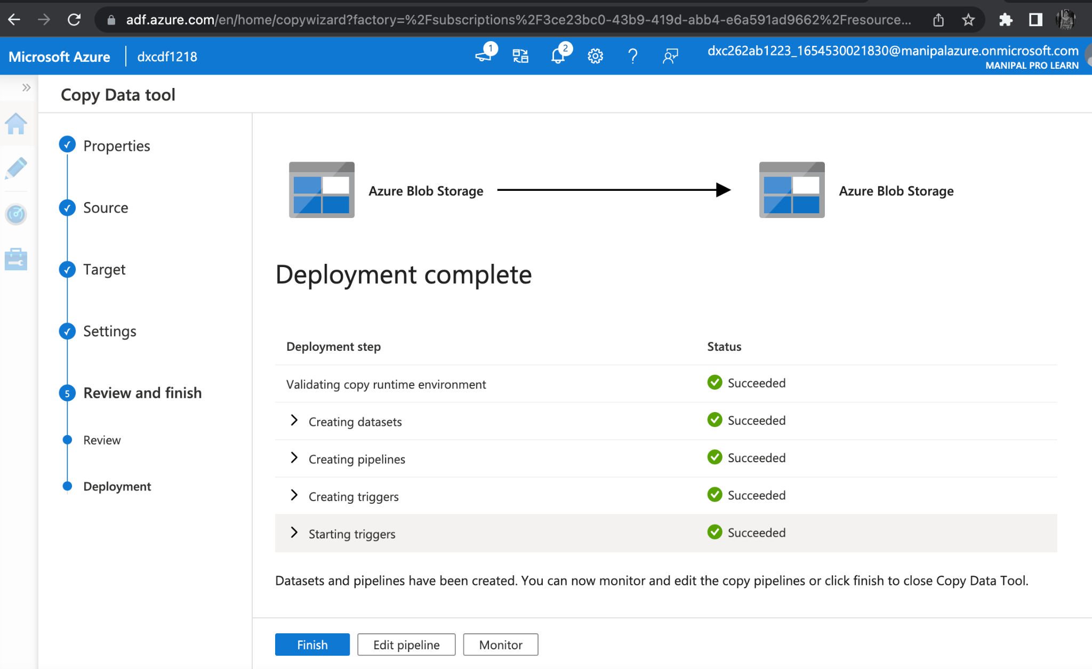
CREATE AZURE DATA FACTORY PIPELINE
PIPELINE CREATED.

Slide 9
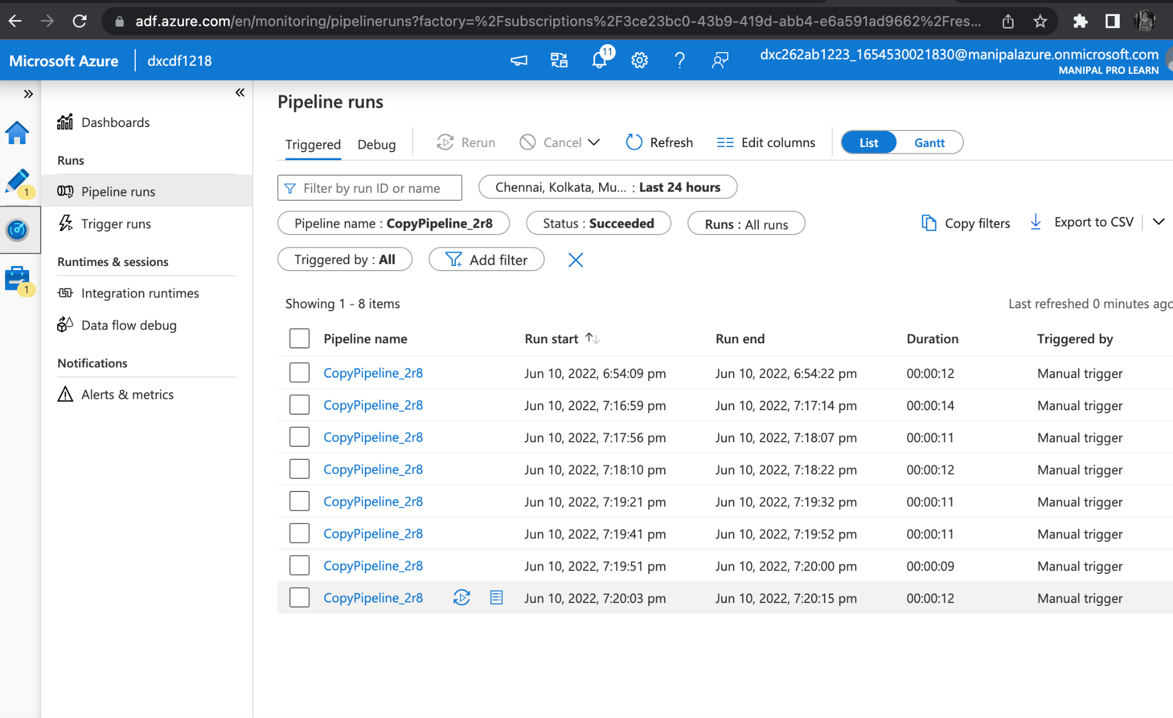
CREATING BLOB TRIGGER
TRIGGER RUN SUCCESSFUL

Slide 10
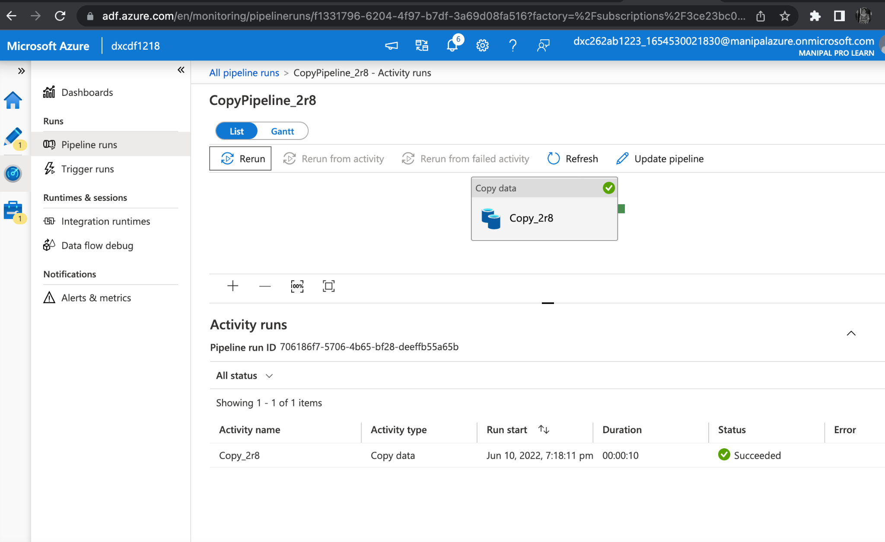
BLOB TRIGGER
BLOB TRIGGER

Slide 11
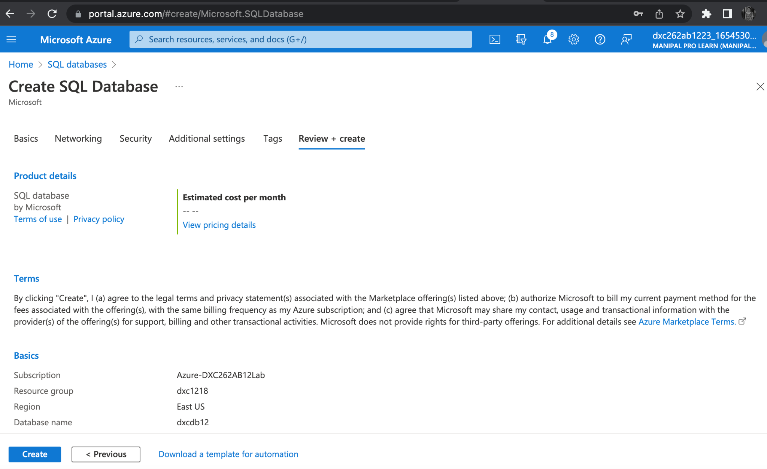
AZURE SQL DATABASE
Create SQL Server and SQL Database

Slide 12
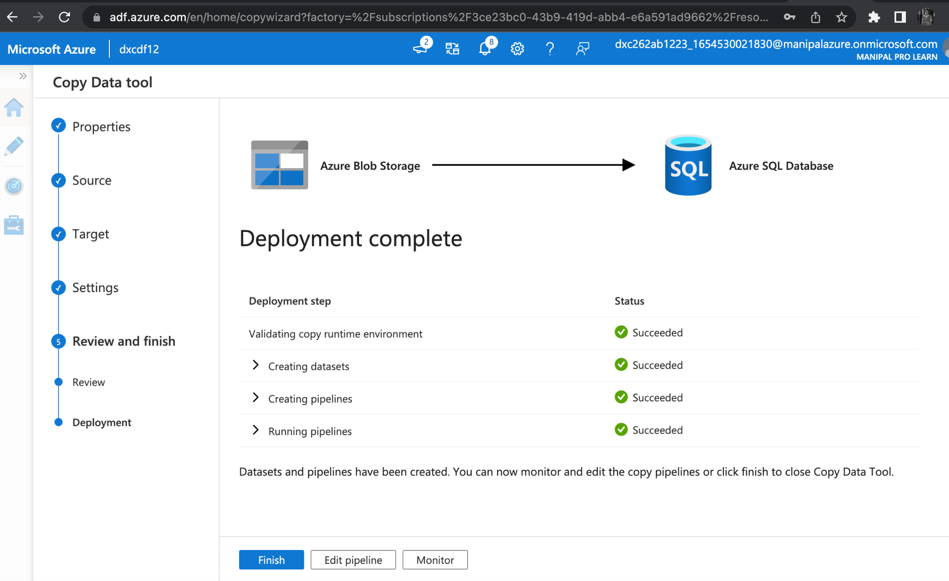
Adding another pipeline to move data from staging to SQL Database
PIPELINE SUCCESSFUL

Slide 13
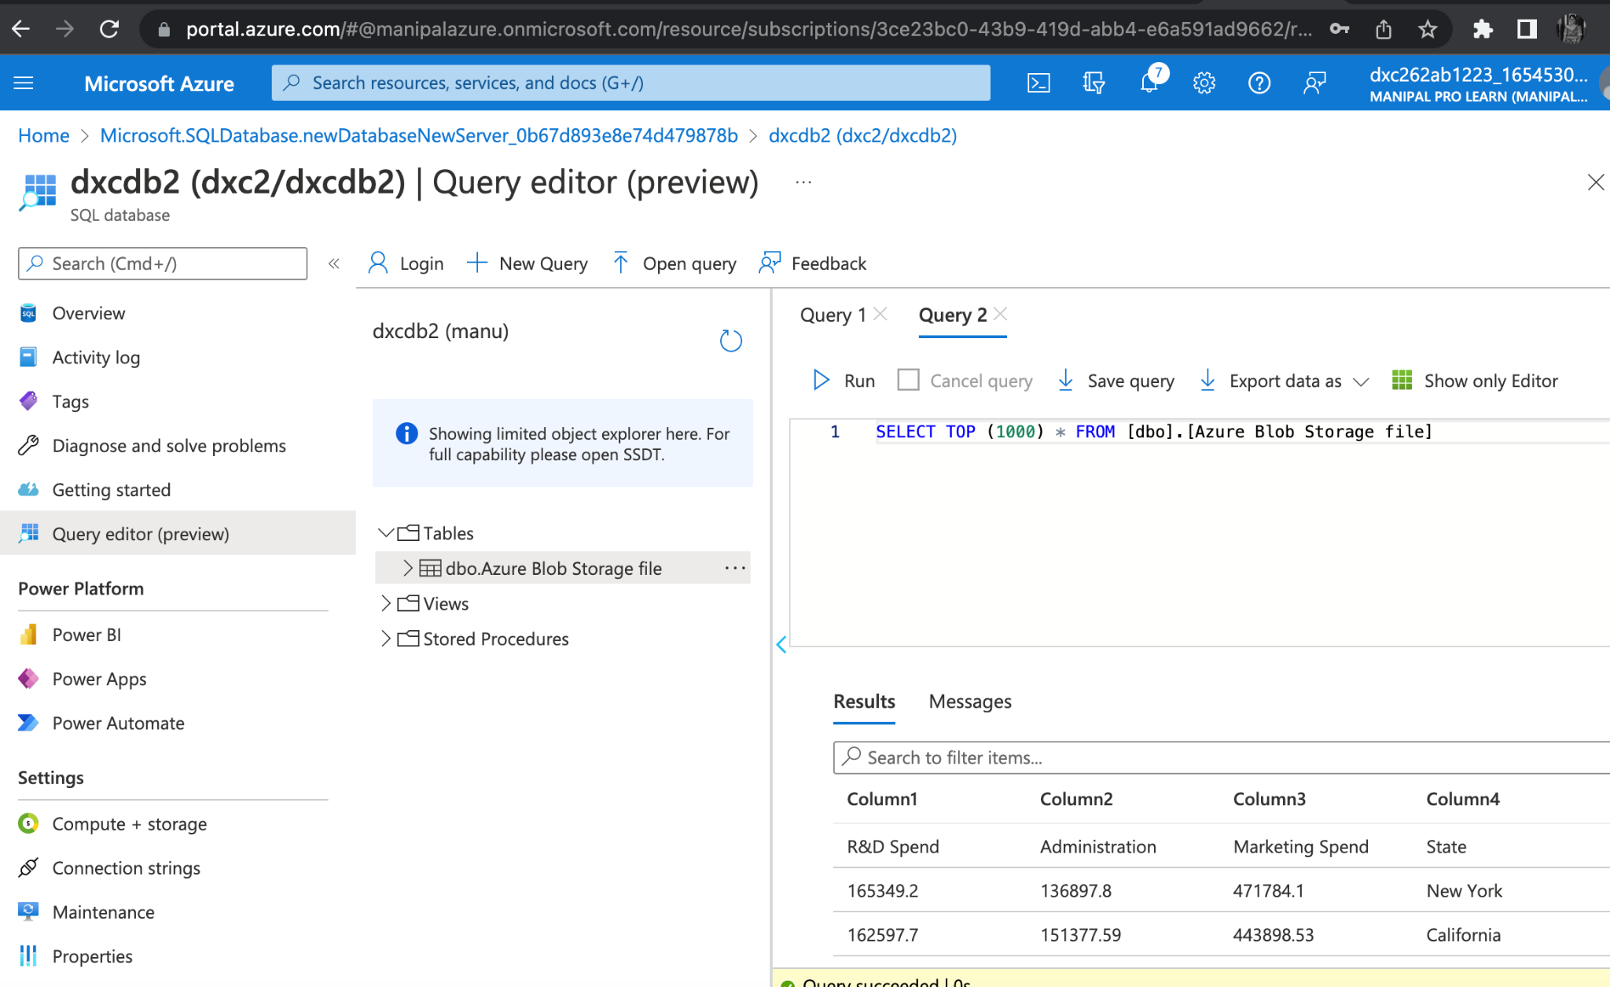
RESULT
Navigate towards the SQL database in order to check the data.

Slide 14
CONCLUSION
Using Azure Data Factory, we were able to create a pipeline that will validate and copy the blob data into the SQL database in this project.
The Blob data has been validated and put in the SQL database.

Slide 15
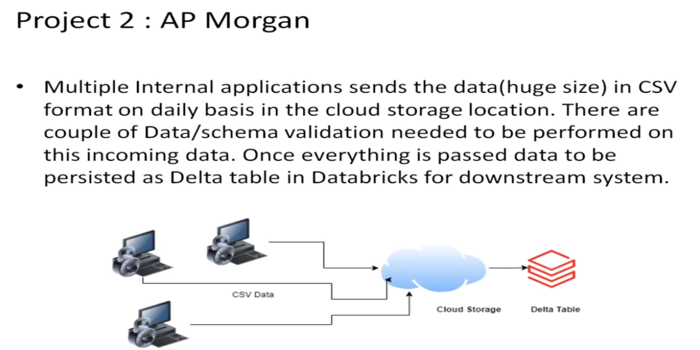
PROJECT 2 : AP MORGAN DATA PLATFORM
AIM : Azure Databricks Linked Service in Azure Data Factory.
PROJECT OUTLINE:

Slide 16
OUR TASK
Create data bricks
Creating the cluster in data bricks
Adding notebook in databricks and Implement BI
Creating data factory
Creating azure data bricks linked service in azure data factory

Slide 17
RESOURCES
To complete this project we need the resources
Azure Data Factory
Azure Data Bricks

Slide 18
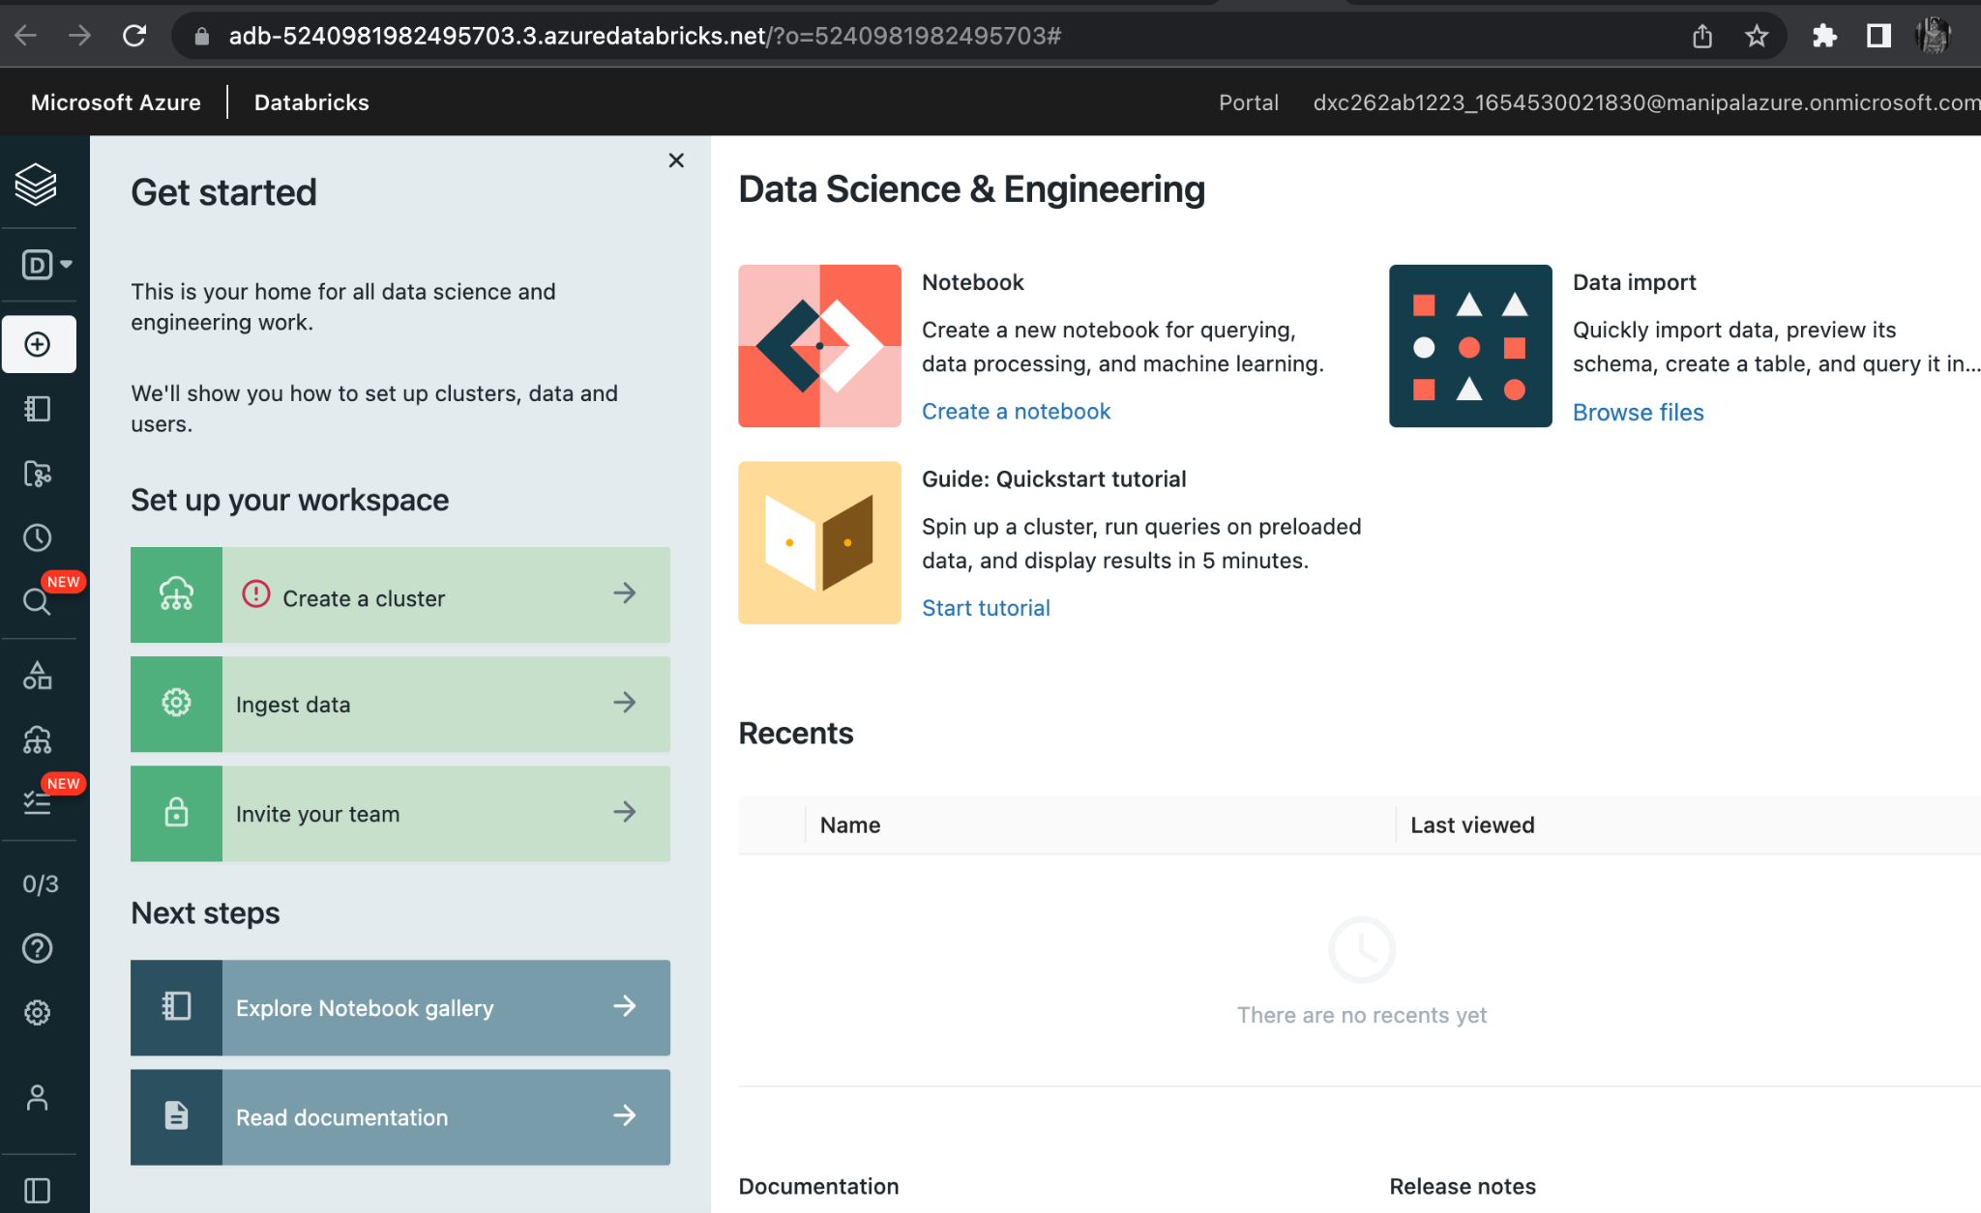
AZURE DATA BRICKS
Create Azure DataBricks workspace.

Slide 19
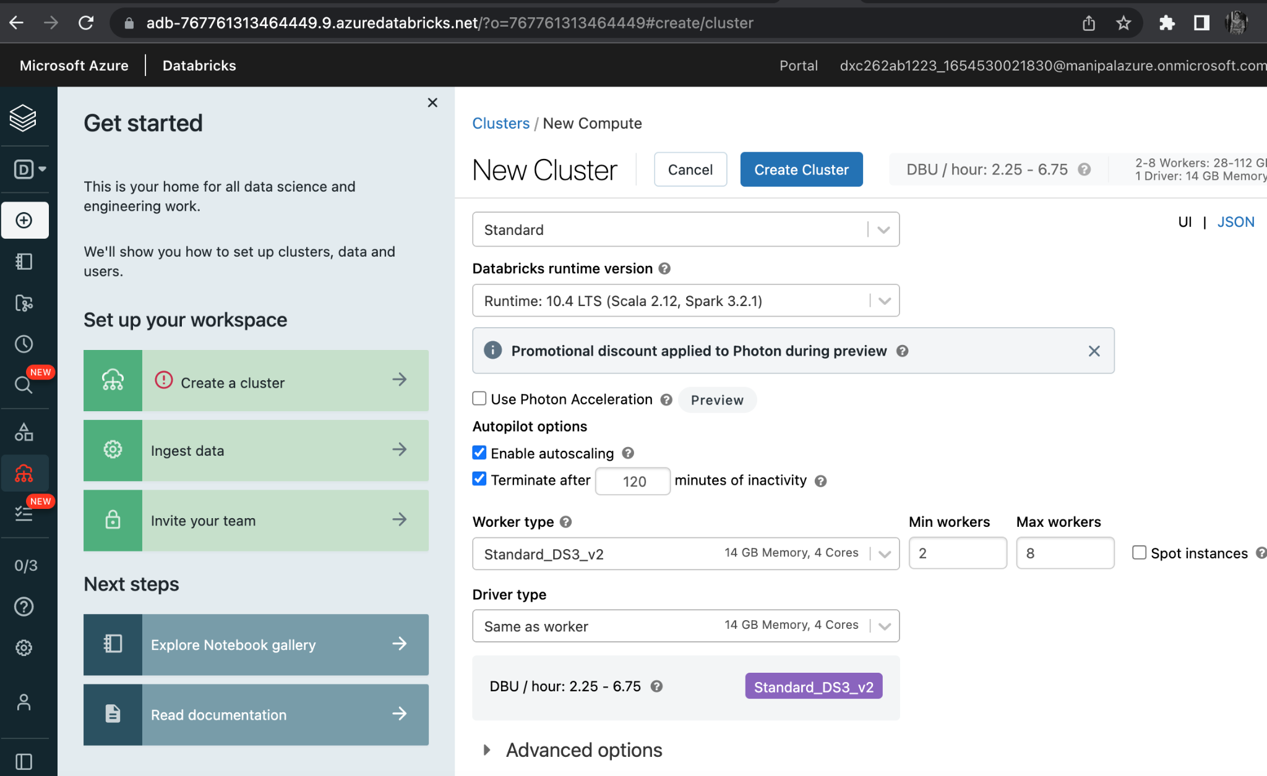
CREATING A CLUSTER IN THE DATABRICKS
CLUSTER CREATED

Slide 20
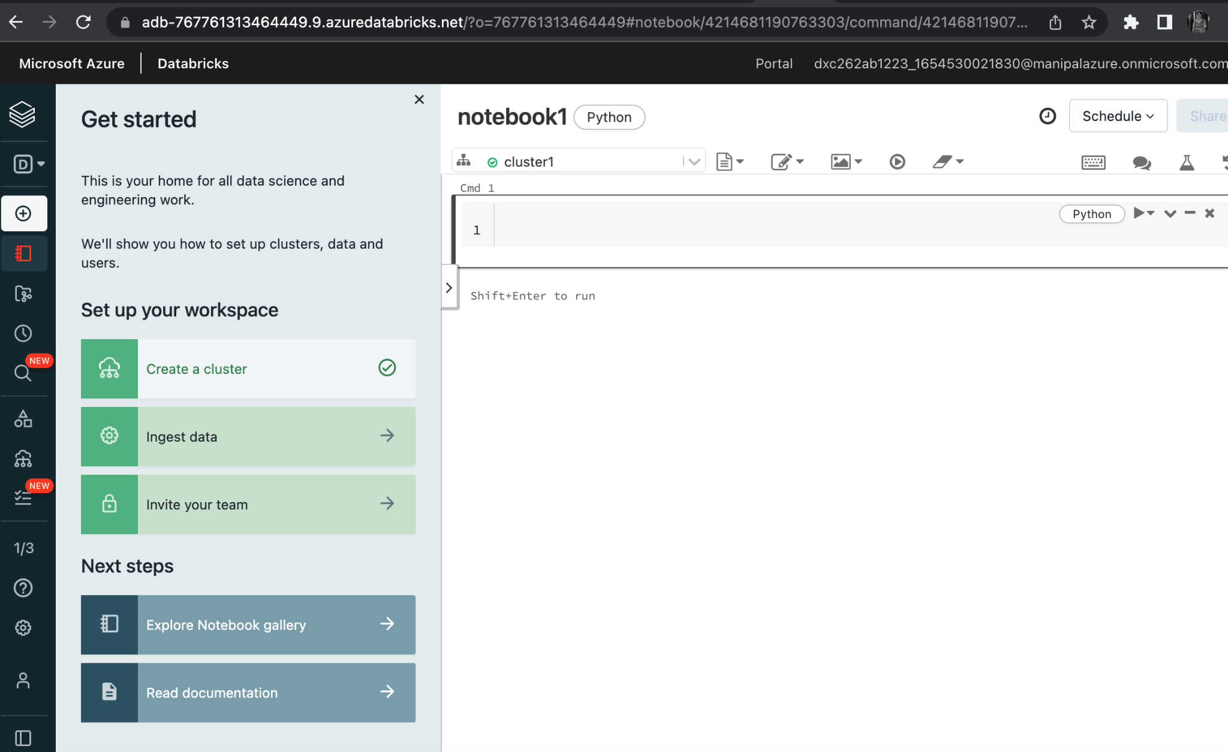
ADDING NOTEBOOK IN THE CLUSTER
NOTEBOOK CREATED.

Slide 21
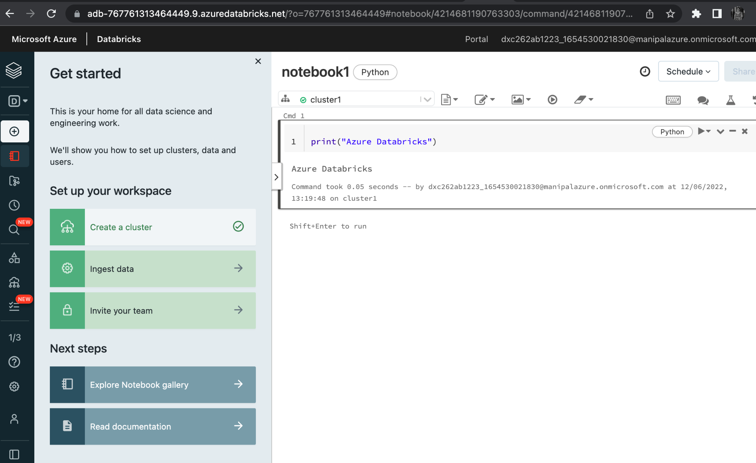
IMPLEMENT BUSINESS LOGIC IN THE NOTEBOOK
BI IS IMPLEMENTED.

Slide 22
CREATE AZURE DATA FACTORY
DATA FACTORY CREATED.

Slide 23
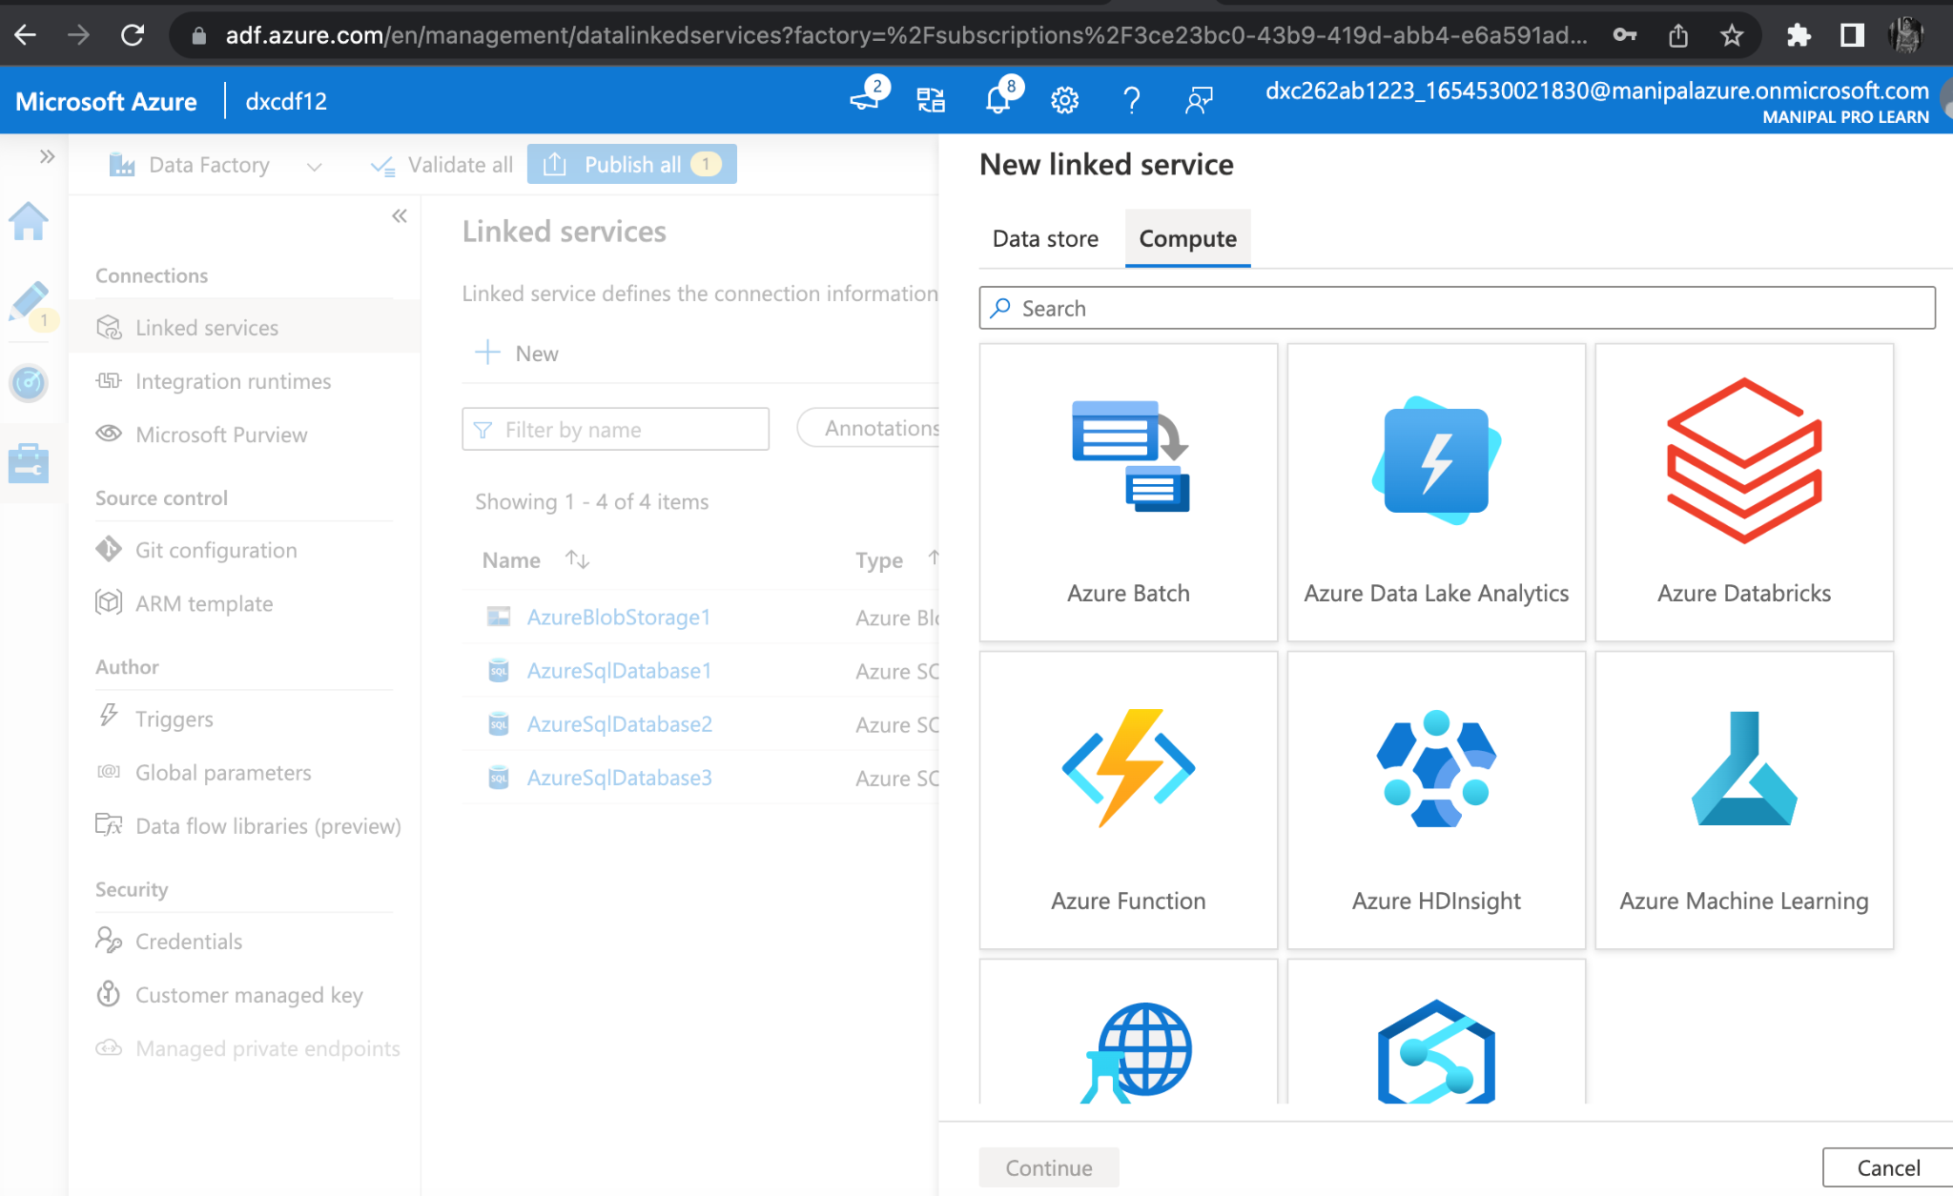
Azure Databricks Linked Service in ADF
Click Linked services under Connections, then select Add New from the Manage option on the left side.
Select Compute > Azure Databricks and then Continue in the New connected service box.

Slide 24
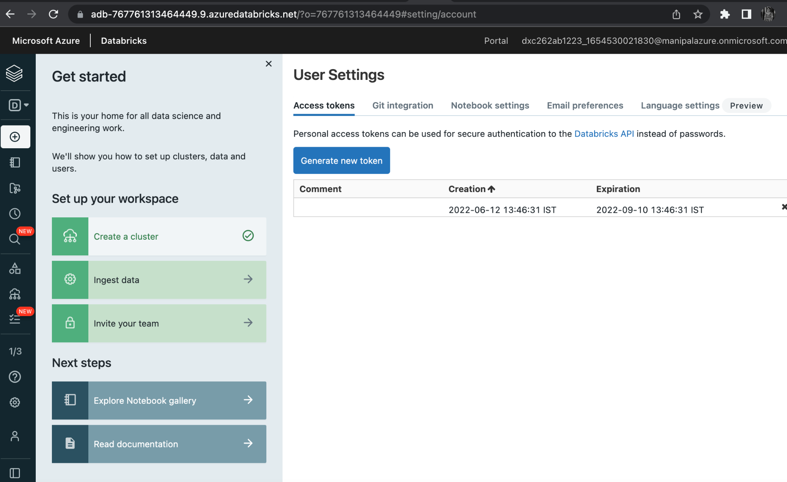
Azure Databricks Linked Service in ADF
GENERATE ACCESS TOKEN.

Slide 25
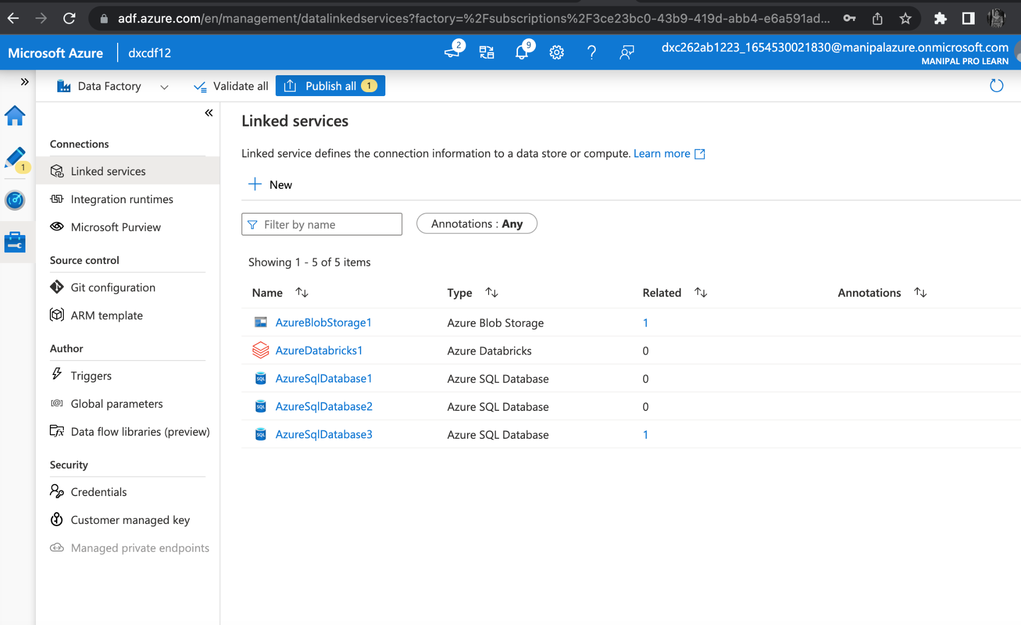
Azure Databricks Linked Service in ADF
Azure Data Bricks is successfully linked.

Slide 26
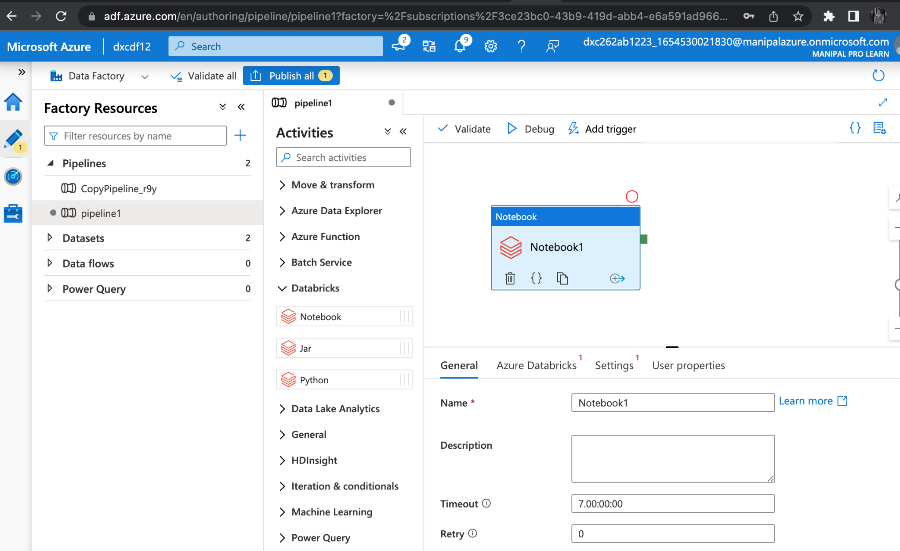
Azure Databricks Linked Service in ADF
Now create a pipeline
Drag the notebook tab from the Azure Databricks drop down onto the workspace of the pipeline

Slide 27
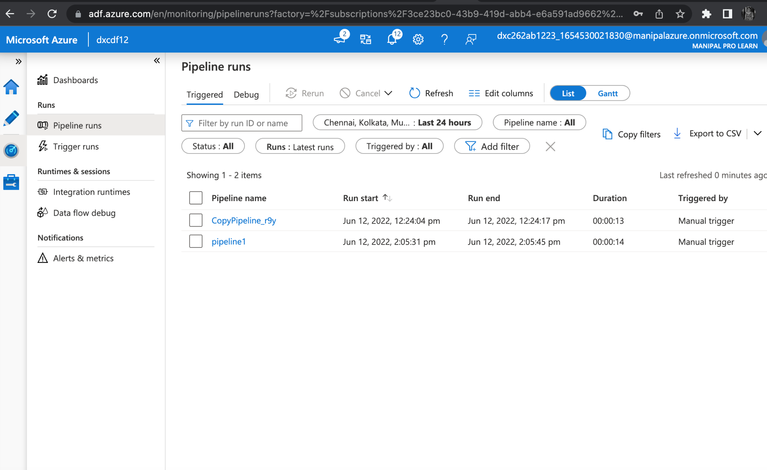
Azure Databricks Linked Service in ADF
Publish the pipeline and then we can trigger and run the pipeline
Trigger the pipeline and monitor the pipeline run

Slide 28
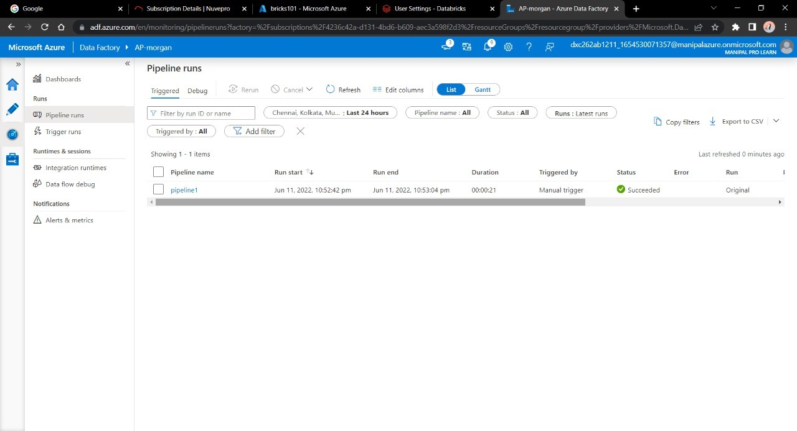
RESULT
Data Factory has successfully triggered a linked notebook of Data bricks.

Slide 29
CONCLUSION
Using Data Factory, I was able to successfully link and trigger an Azure DataBricks notebook.
Azure Data Factory and Azure Data Bricks are related.

Slide 30
REFERENCES
https://docs.microsoft.com/en-us/azure/data-factory/concepts-pipeline-execution-triggers

Slide 31


